Slide 1





Pair Perfection Presented.
Task
Manager
Make your daily task more easier!

Slide 2
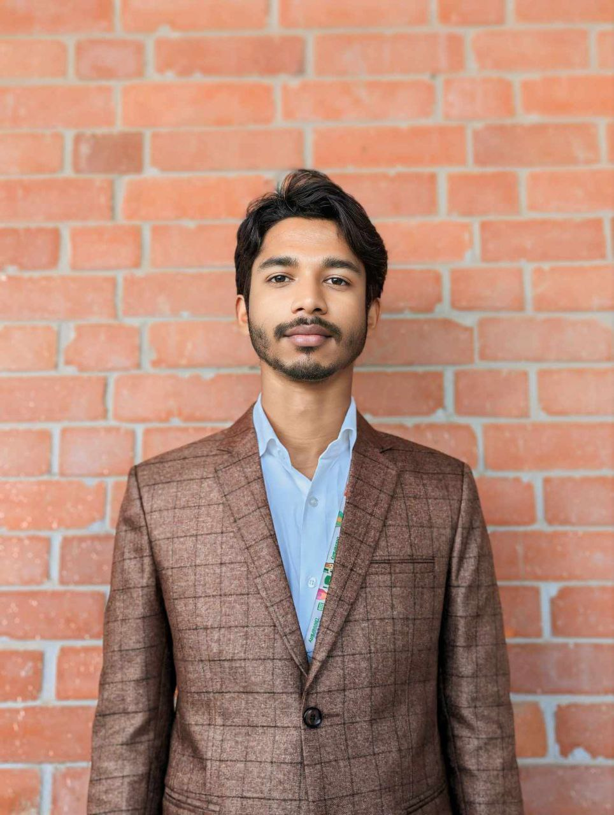
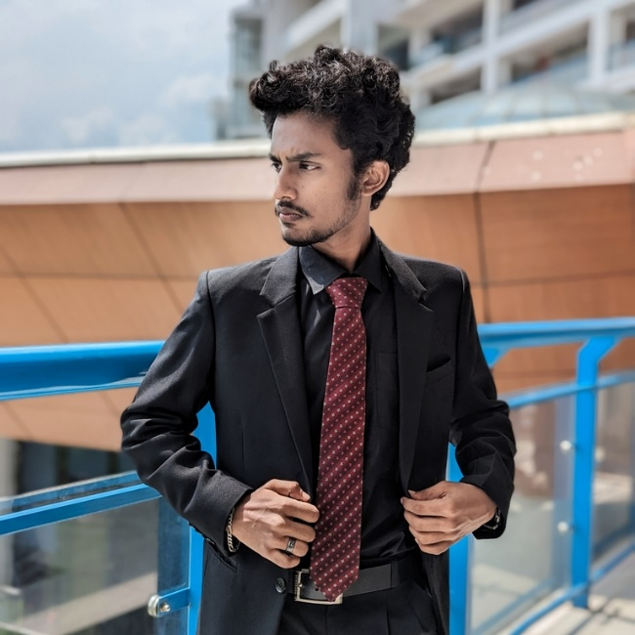
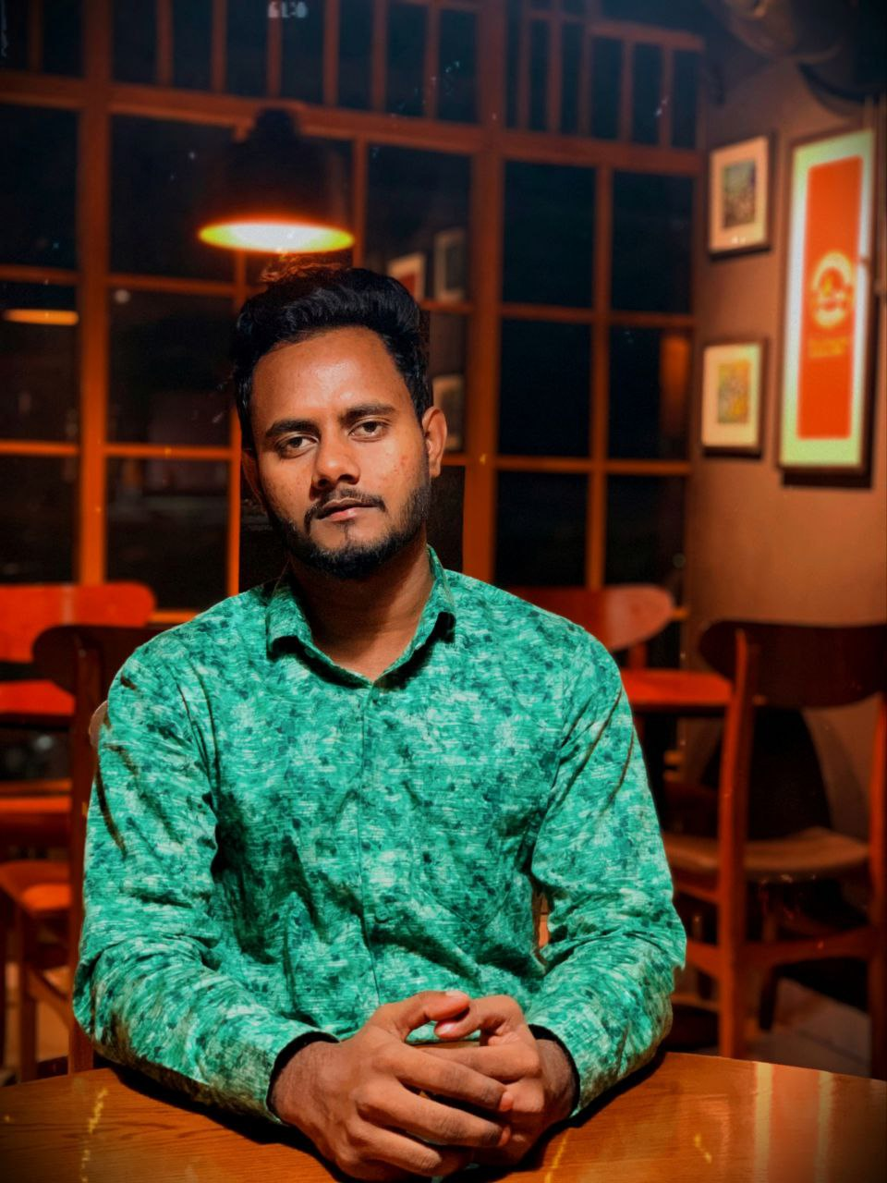
OUR TEAM
Meet our amazing team
MUSFIQUR RAHMAN ZIHAD
MD.ABDUL HAMIM LEON
MD. RUBEL MIAN
DEVELOPER
DEVELOPER
DEVELOPER
Will work with Web in this project
Will work with Android in this Project
Will work with IOS in this Project

Slide 3
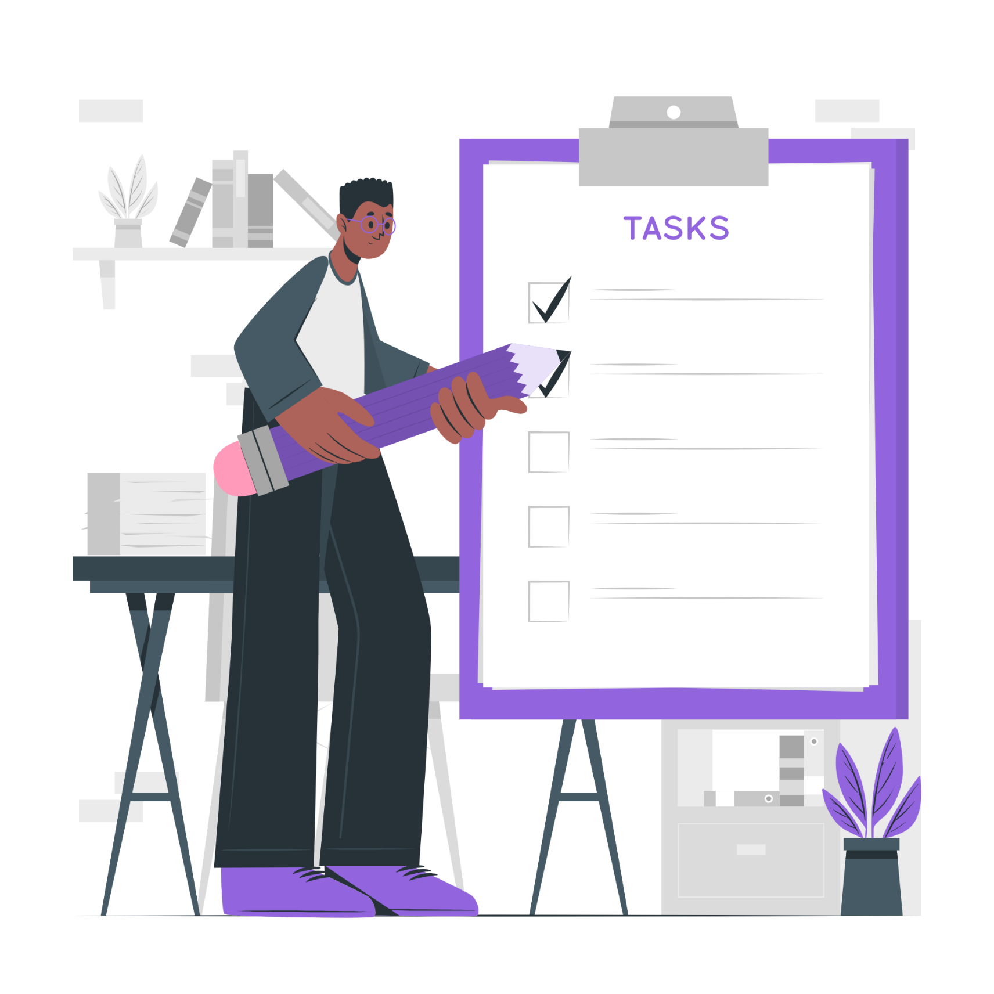
Project
Overview
A user can organize his/her daily tasks through this software. Not only that, he can update and delete his task’s deadline, task’s notification, task’s status through it. Also the user can manage his profile.

Slide 4

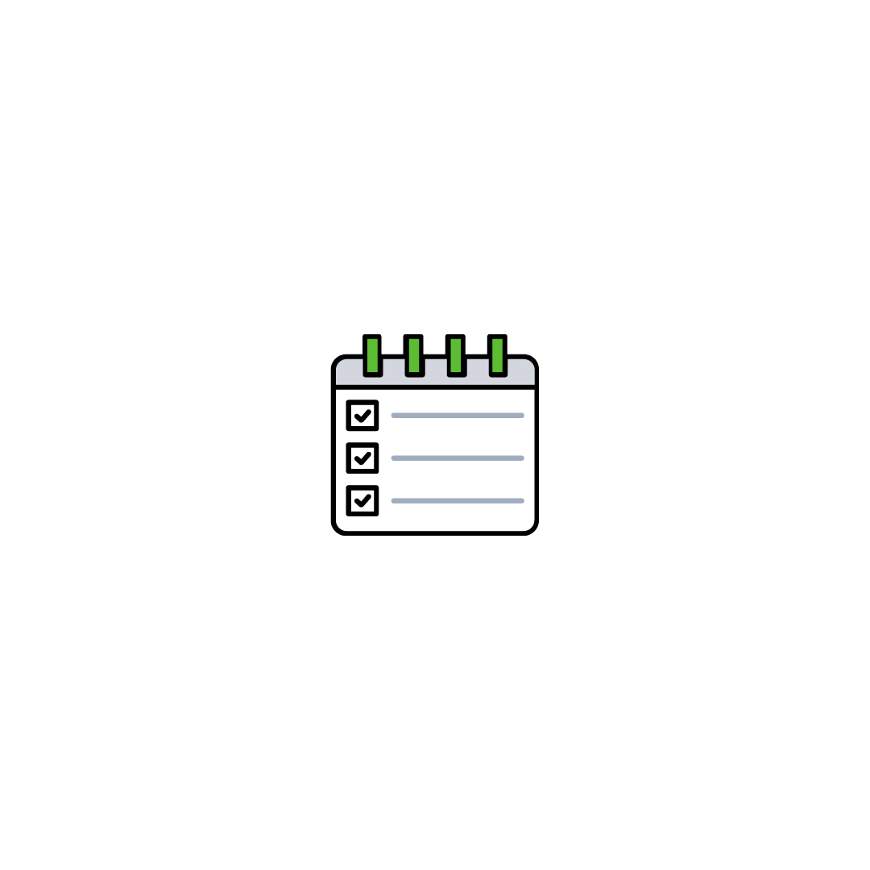
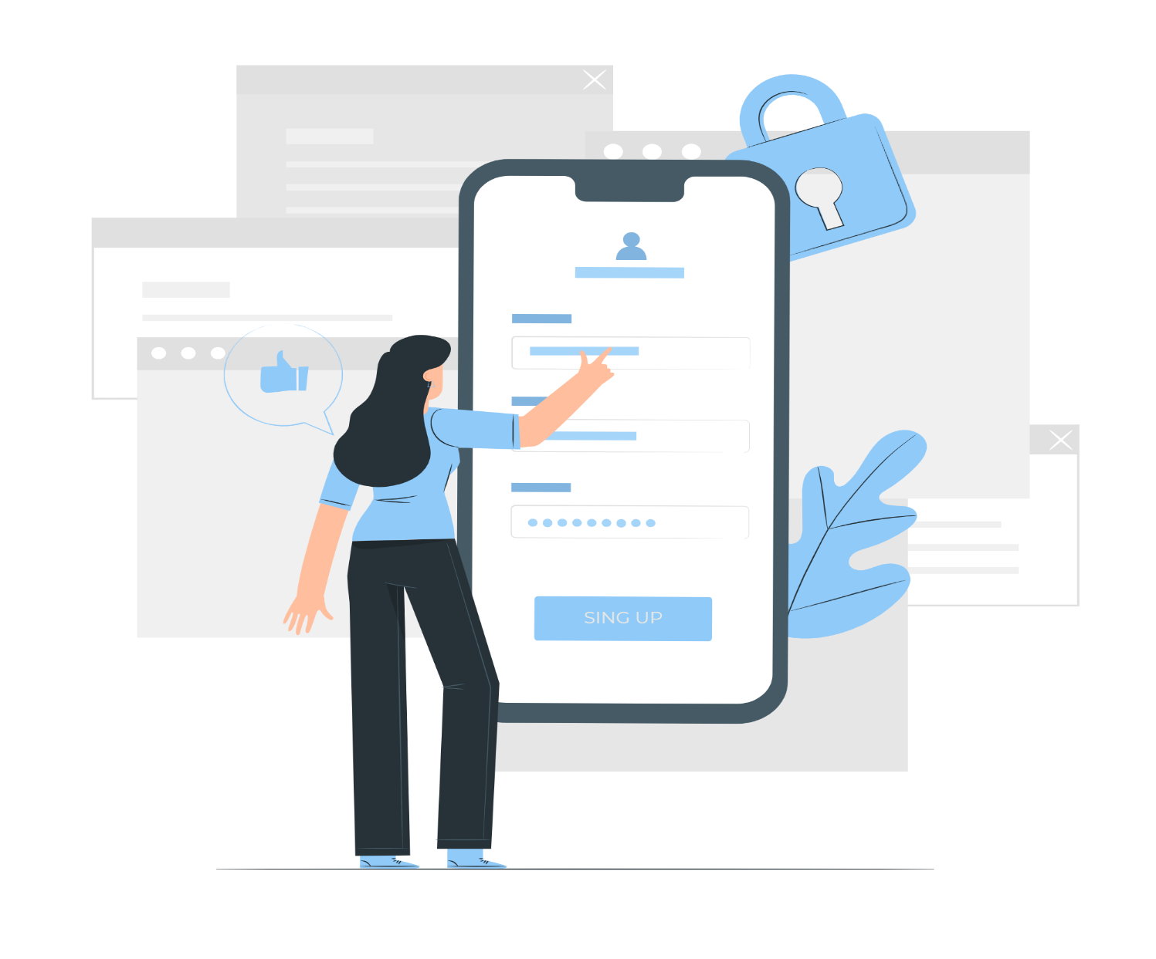

WHAT WE AIM FOR
To Develop an
User-Friendly Software For All Types of Users.
Optimized
Network & Data Optimized
Responsive
Minimize Rebuilds
Memory Management
Always Maintain

Slide 5




PLATFORMS OF OUR PROJECT
Multi Platform
Presentations are communication tools that can be used as lectures, speeches, reports, and more. It all depends on the purpose.
Web Platform
Android Platform
Initial Launch
Initial Launch
IOS Platform
Future Launch

Slide 6




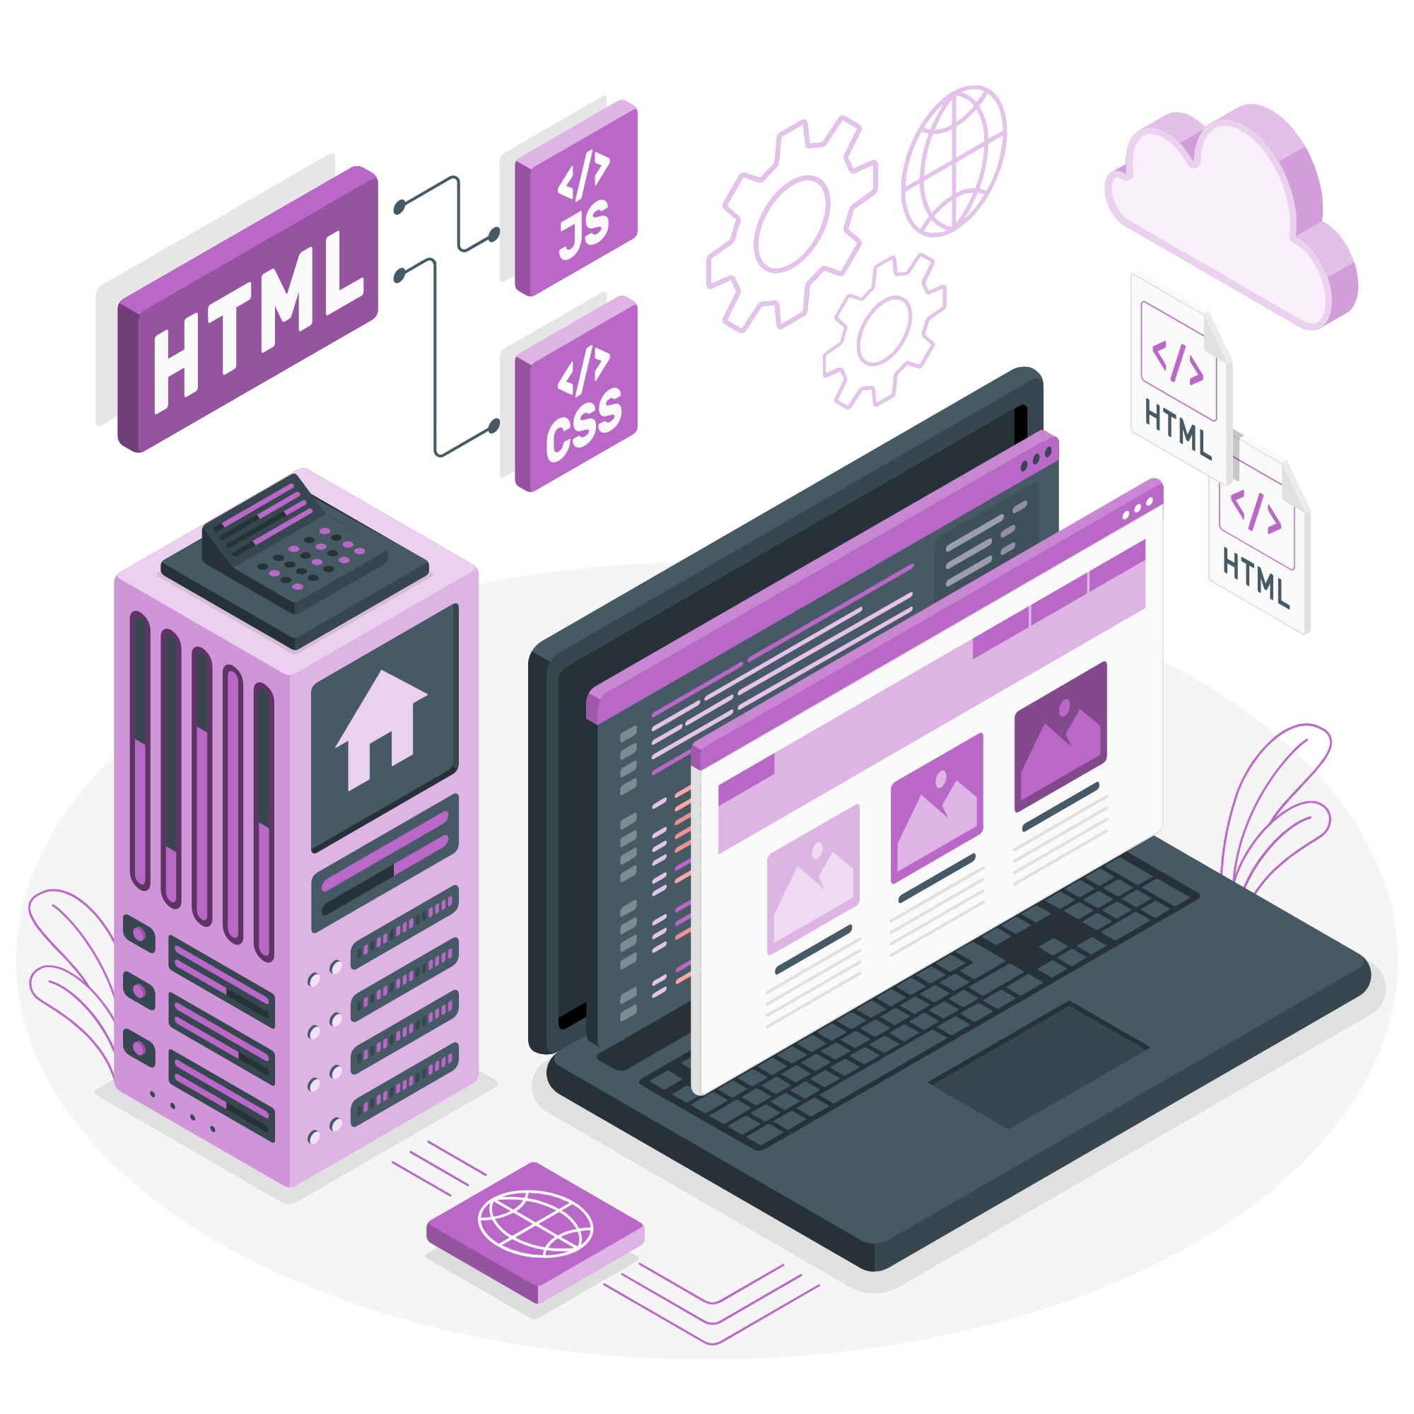
WORK FLOW OF
Web Platform

Slide 7


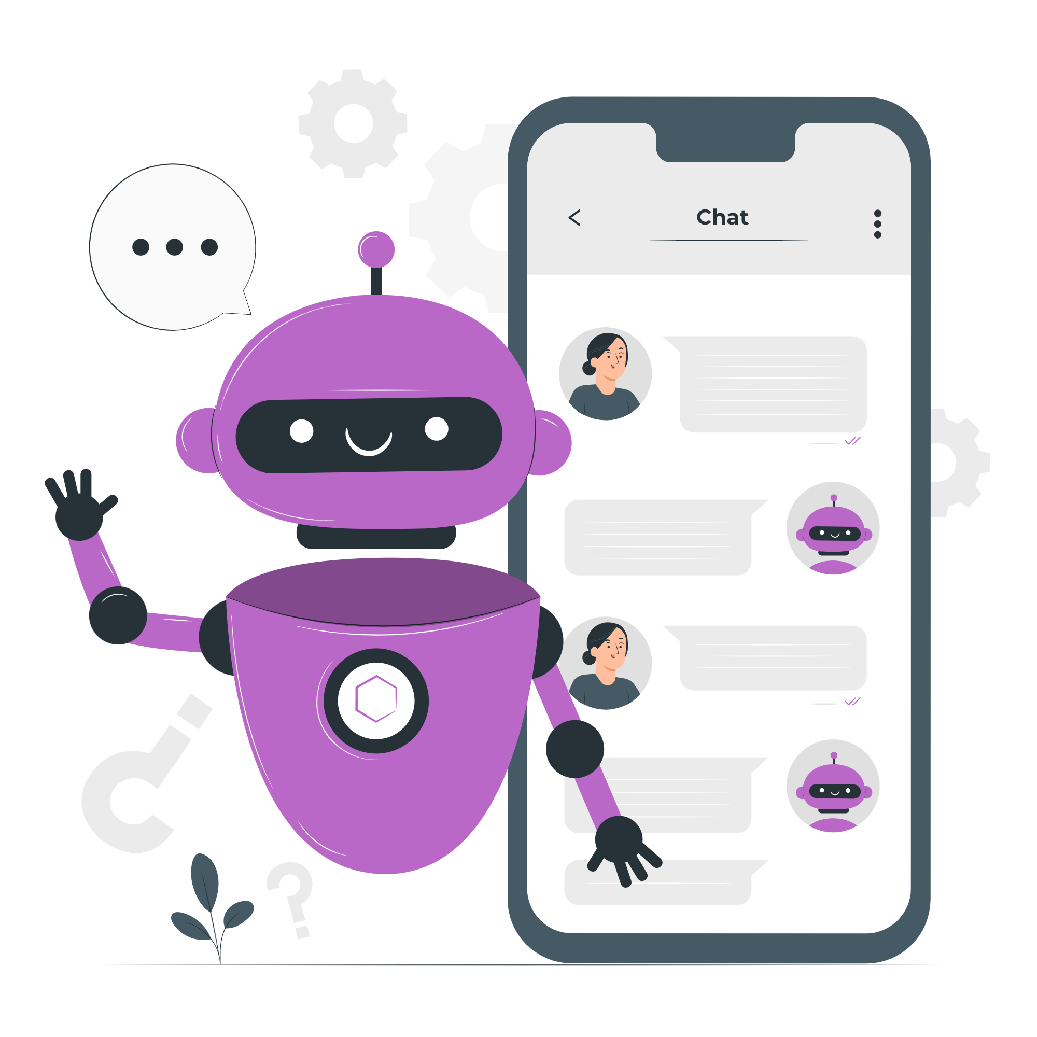
WORK FLOW OF
Android Platform

Slide 8
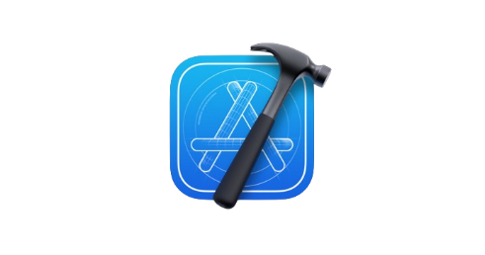
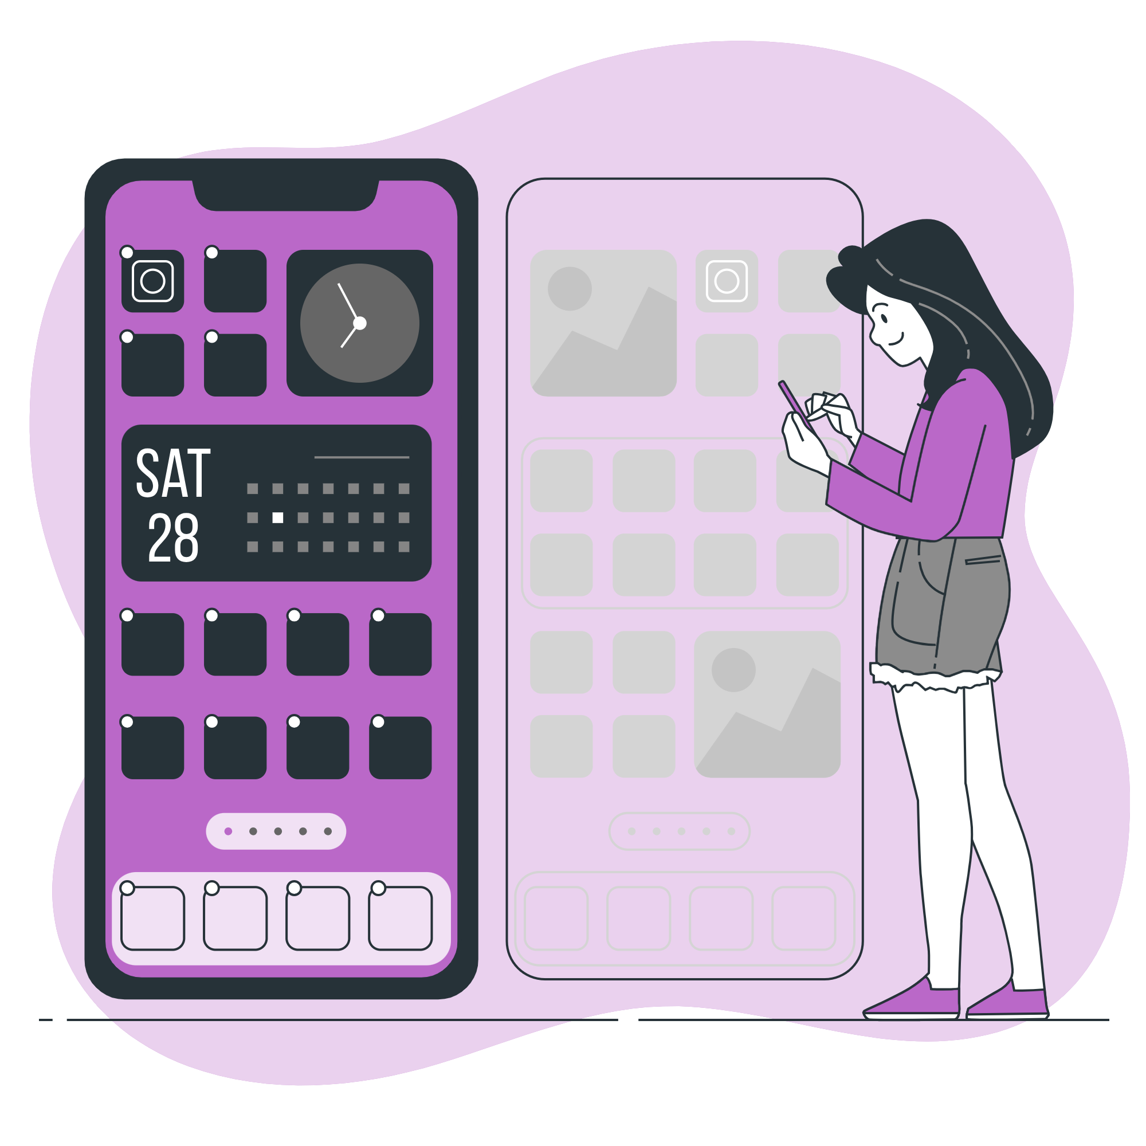
WORK FLOW OF
IOS Platform

Slide 9
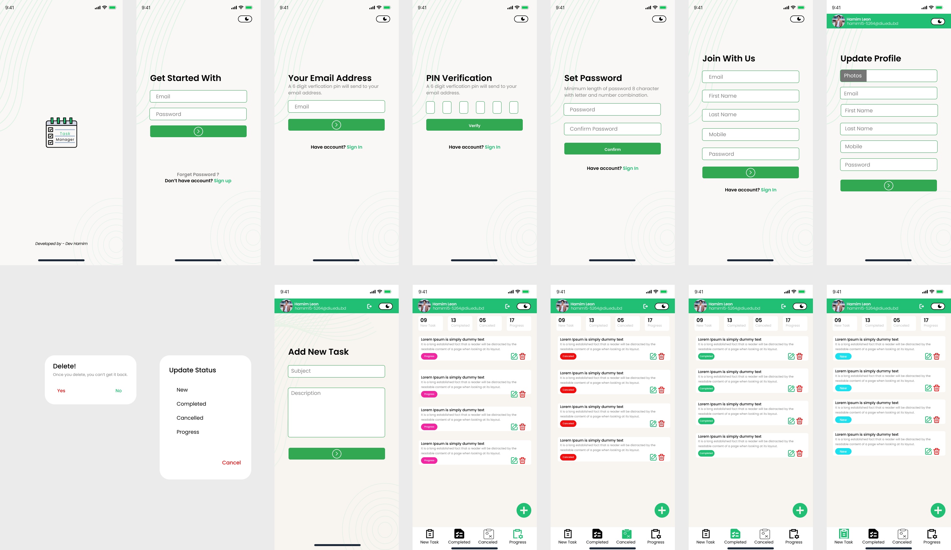
Initial Features

Slide 10






Future Work
Task Timeline
Timeline Warning
Notification
Assign Date
Sprint

Slide 11
Thank You

